Slide 1
All-Pay Bidding Games on Graphs
Review and Game Implementation
Yinjie Li, Jiaying Du, Ziyang Sheng, Yuesong Li, Chengqian Li
School of Information Science and Technology (SIST), ShanghaiTech University
Spring, 2021

Slide 2
Outline
Introduction
Game Value Function
Experiment result
Game demo

Slide 3
Introduction

Slide 4
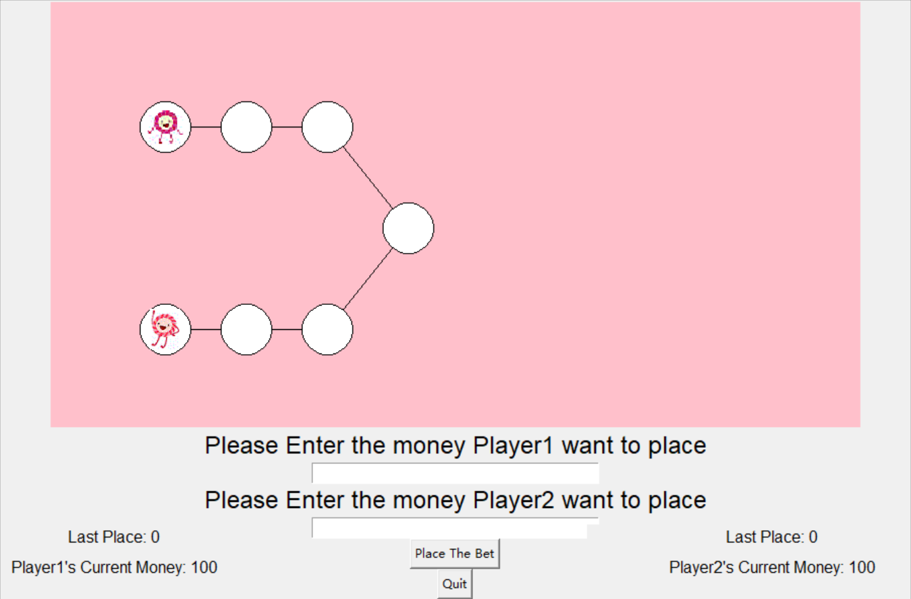
Game rules
General rules:
Two players
Each has a total budget
Bid simultaneously
Winner moves one step
Winning Condition:
One player reaches the leaf.
Mode 1(All-pay): The bank gets both players’ bids.
Mode 2(Richman): The loser in this round will get the winner’s bid.
Mode 3(Poorman): The bank only gets the winner’s bid.

Slide 5
Game Value Function

Slide 6
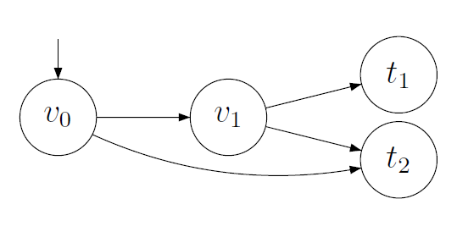
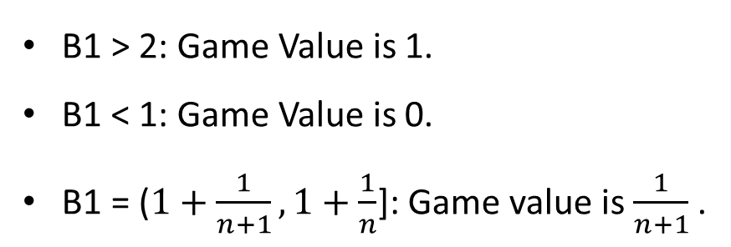
Game Value
Fundamental Case: All-pay bidding game G(2,1)
Game Value: Given the initial budget ratio, player 1 has a strategy that guarantees a probability of winning.
B1 > 2: Game Value is 1.
B1 < 1: Game Value is 0.
B1 = ($1+\frac{1}{n+1}, 1+\frac{1}{n}$]: Game value is $\frac{1}{n+1}$ .
Player 1: Budget B1, needs to win twice.
Player 2: Budget B2 = 1, needs to win once.
ε Discretization

Slide 7
Upper / lower bound
Upper-bound
For every vertex in the graph, if the budget ratio (Player 1’s budget / Player 2’s budget) is larger than upper-bound, then Player 1 has a dominant strategy.
Lower-bound
For every vertex in the graph, if the budget ratio (Player 1’s budget / Player 2’s budget) is smaller than lower-bound, Player 2 has a strategy that guarantees winning with positive probability.

Slide 8
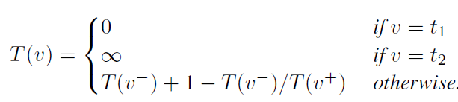
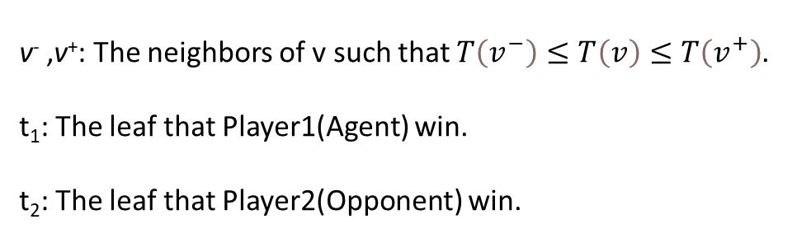
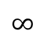
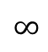
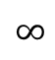
Upper / lower bound
Calculation method for Upper-bound
Initial state (0,0)
Player 1
0
0
Player 2
Upper-bound of vertex v
0
v⁻ ,v⁺: The neighbors of v such that $T\left(v^{−}\right)≤T\left(v\right)≤T\left(v^{+}\right)$.
t₁: The leaf that Player1(Agent) win.
t₂: The leaf that Player2(Opponent) win.
$$∞$$
$$∞$$
$$∞$$
G(3, 3): Both need to win 3 rounds.
G(i, j): Player 1 needs to win i rounds while player 2 needs to win j rounds.

Slide 9
Experiment Result

Slide 10
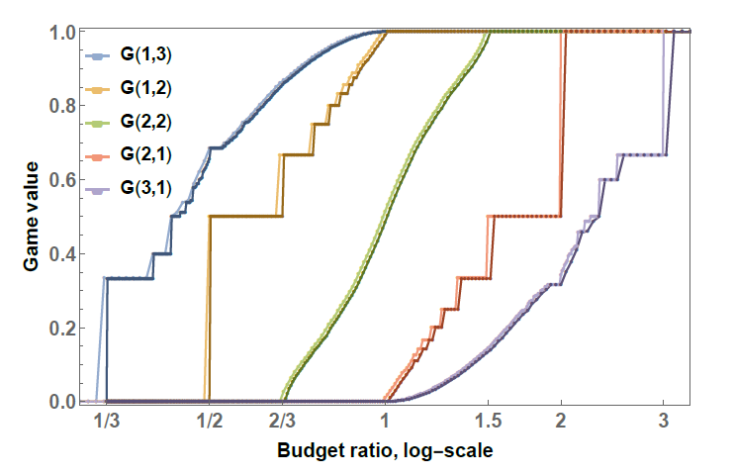
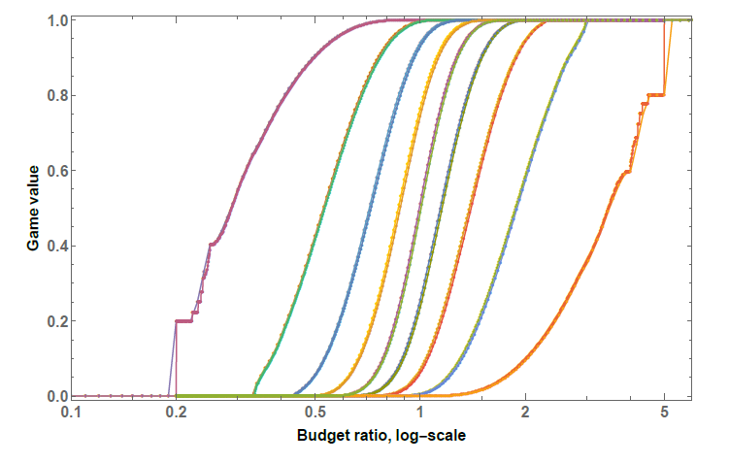
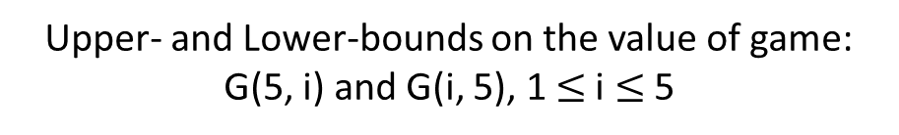
Experiment Result
Upper- and Lower-bounds on the value of game:
G(1,3), G(1,2), G(2,2), G(2,1), G(3,1)
Upper- and Lower-bounds on the value of game:
G(5, i) and G(i, 5), 1 $≤$i $≤$ 5

Slide 11
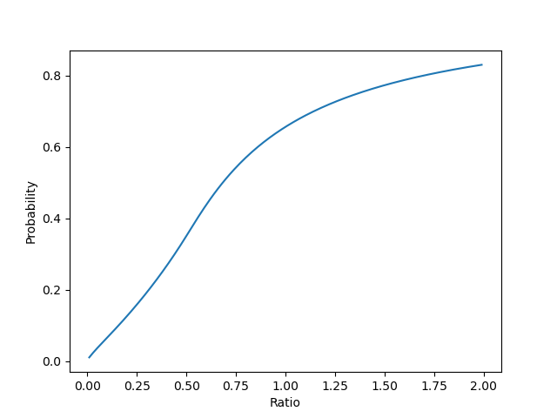
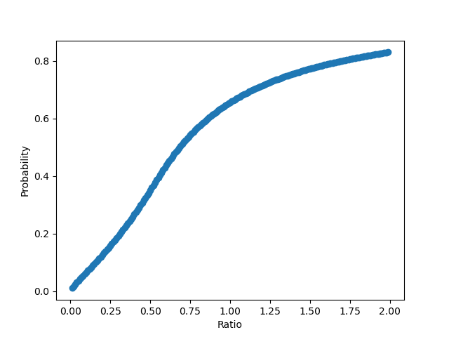
Experiment Result
Traversing all the bid strategies for both players in G(2,1).

Slide 12
Demo

Slide 13


Slide 14
Thank you for listening!

